Slide 1
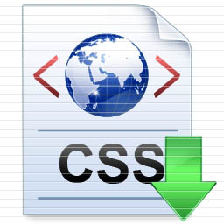
Presentation
Group 2

Slide 2
1. Introduction
What is CSS?
→ Cascading Style Sheets
→ A style sheet language used for describing the look and formatting of a document written in a markup language
→ Often used to change the style of web pages and user interfaces in HTML and XHTML

Slide 3
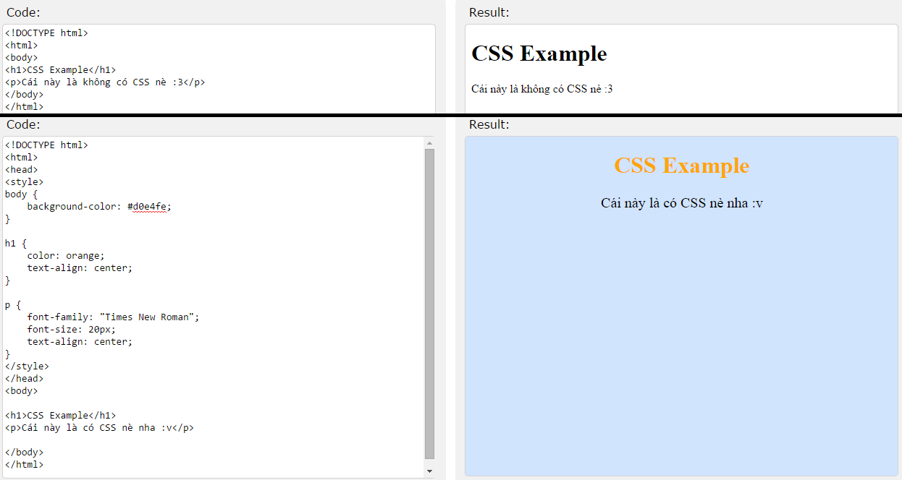
Ex :

Slide 4
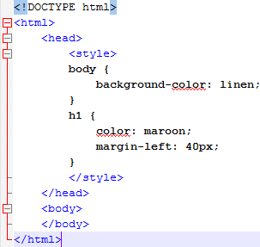
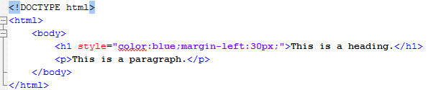
2. Insert CSS
1 . Internal style sheet
2 . Inline style

Slide 5
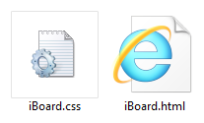
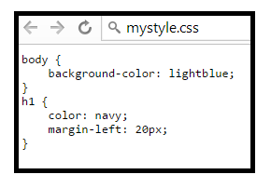
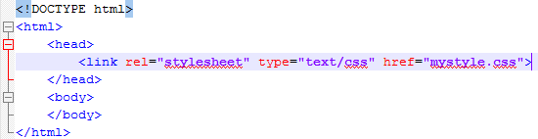
2. Insert CSS
3 . External style

Slide 6
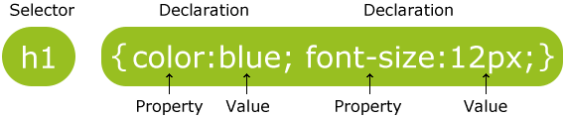
3. Syntax
The selector points to the HTML element you want to style
The declaration block contains one or more declarations separated by semicolons
Each declaration includes a property name and a value, separated by a colon

Slide 7
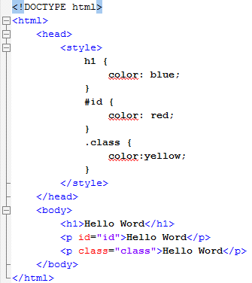
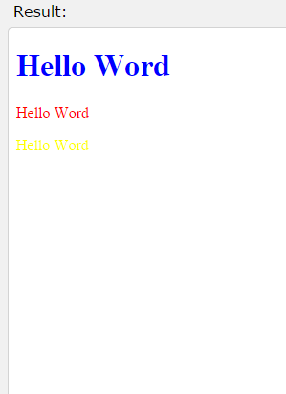
4. Selector
Selector :
Element
Id
Class

Slide 8
5. Properties & values

Slide 9
More about CSS
http://www.w3schools.com/html/

Slide 10
6. Bootstrap
Bootstrap is a free collection of tools for creating websites and web applications
Bootstrap contains HTML and CSS-based design templates for text, forms, buttons, navigation and other components

Slide 11
What Does Bootstrap Include?
Scaffolding: Contains layout, grid system, fluid grid system, and responsive design
Base CSS: Contains classes for typography, tables, forms, buttons, images, and more
Components: Contains reusable components: icons, dropdowns, navbars, breadcrumbs, alerts, and more
JavaScript Plugins: Contains over a dozen custom jQuery plugins. You can include them all, or one by one
Customizable Components : Customize Bootstrap's components, LESS variables, and jQuery plugins to create your own version

Slide 12
Bootstrap's Default Settings
The <body> element have a font-size of 14px, and a line-height of 1.428.
In addition, all <p> elements have a bottom margin that equals half their computed line-height (10px by default).

Slide 13
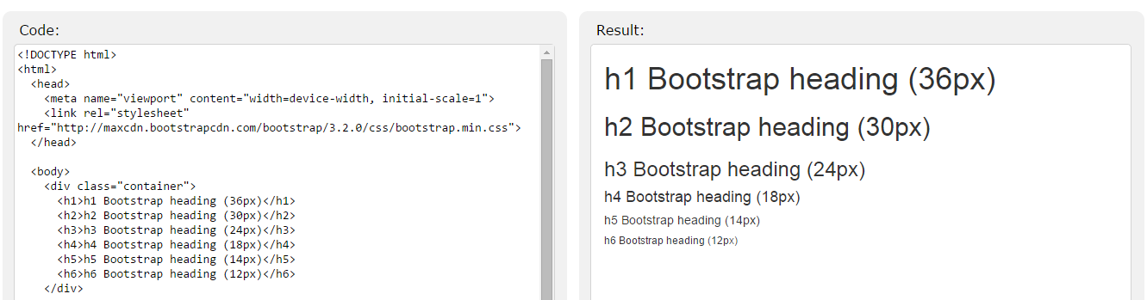
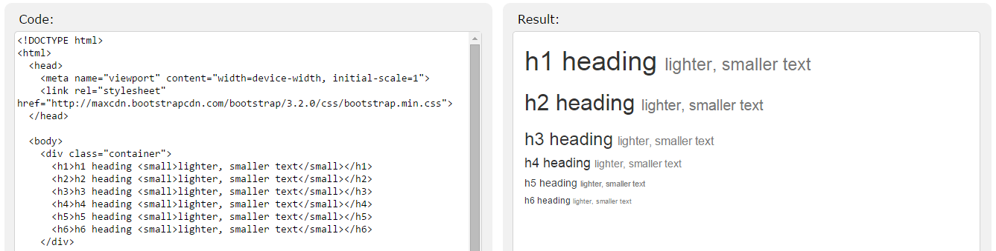
Text Elements

Slide 14
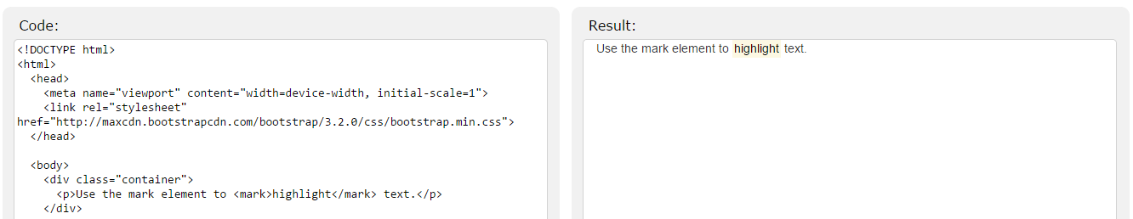
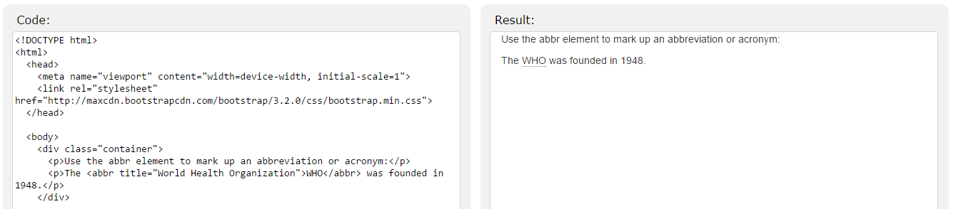
Text Elements

Slide 15
More about BOOTSTRAP
http://www.w3schools.com/bootstraps/
http://getbootstrap.com/

